Slide 1
MOT1421: Economic Foundations Course structure
8 weeks: 8 Lecture Notes -> all material has been posted on BS.
Micro-economics (4 weeks) and Macro-economics (4 weeks).
Micro-economics: (1) Demand; (2) Supply: perfect competition; (3) Supply: monopoly; (4) Supply: oligopoly; (5) production and optimal choice of technique; and (6) innovation, technological progress, and evolutionary market model.
Macro-economics: (1) national accounting, concepts, definitions; (2) neoclassical macro-model; (3) Keynesian macro-model; (4) IS-LM model; and (5) theories of money creation.

Slide 2
MOT1421: Economic Foundations Course structure
Each Lecture Note contains question sets, exercises and supportive videos.
Each week: 2 self-tests -> one “open” questions; the other MC questions. The MC self-test will be posted on Thursdays.
On Brightspace: under \content -> all course materials have been posted for each week.
There are 2 on-line lectures (in BBB): Monday 13.45-15.30 hrs and Friday 8.45-10.30 hrs.
Exam: 26 January 2022 (13.30-16.30 hrs). Exact format = unknown.
Motto: “The more I read, the more I acquire, the more certain I am that I know nothing.” ― Voltaire.

Slide 3
MOT1421 Economic Foundations Microeconomics
Focus is on one individual market (the ceteris paribus assumption applies to the rest of the economy) & on individual decision-making by consumers and/or producers.
Central questions: (1) how are the many decentralised decisions of market actors co-ordinated and “aggregated” into a market outcome? (2) what motivates these market actors and how do they decide?
Market mechanism: decentralised decisions are co-ordinated by means of price changes. In case of an excess supply, price will go down; in case of an excess demand, price will go up; until (in the end) market equilibrium is reached (supply = demand).
Motivation: (1) consumers are assumed to maximise utility; (2) producers are assumed to maximise profits.

Slide 4
MOT1421 Economic Foundations The Neoclassical theory of demand
Assumptions:
Methodological individualism: representative consumer
Instrumental rationality: max! U (U = utility)
U is ordinal: different consumption bundles can be ranked
The representative consumer is consistent in his/her choices
Consumer preferences are exogenous -> expressed in U-function
Diminishing marginal utility: When I am thirsty, the first glass of water will provide me with more additional utility than the fifth glass of water.
Consumers are sovereign (because preferences are exogenous)

Slide 5



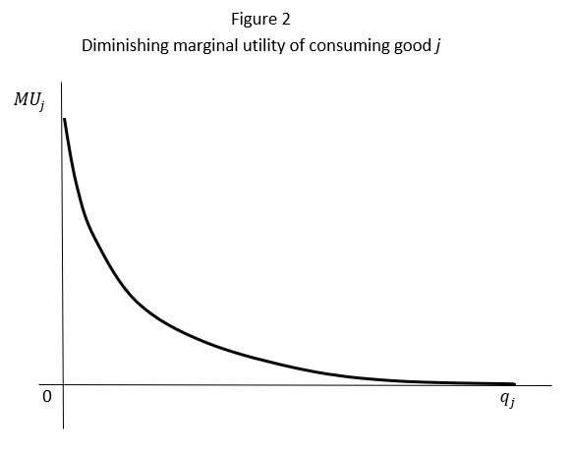
MOT1421 Economic Foundations The Neoclassical theory of demand
The utility function:
First thing to note: marginal utility is always > 0
which means: more is always better. (No satiation)
Second thing to note: diminishing marginal utility

Slide 6


MOT1421 Economic Foundations The Neoclassical theory of demand
The utility function can be rewritten as an indifference curve.
Suppose:
Then the set of indifference curves corresponding to this utility function is:

Slide 7
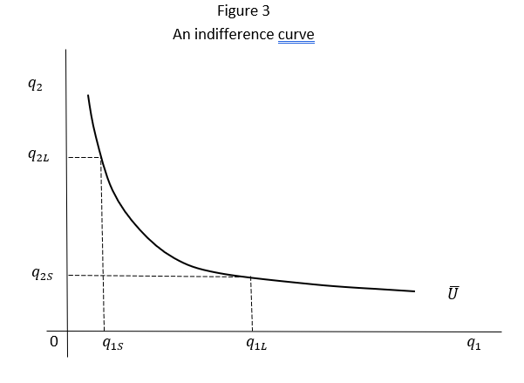

MOT1421 Economic Foundations The Neoclassical theory of demand

Slide 8
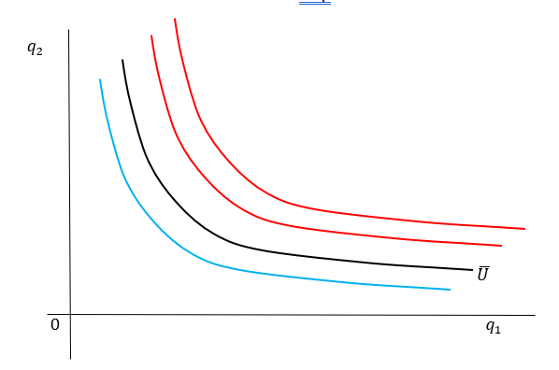
MOT1421 Economic Foundations The Neoclassical theory of demand
An indifference
map:

Slide 9
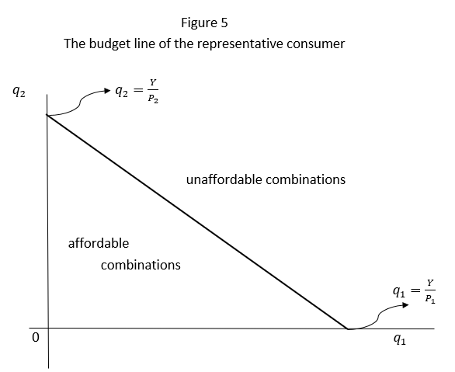

MOT1421 Economic Foundations The Neoclassical theory of demand
The consumer is
constrained in what
he/she can consume
by his/her income
-> the budget
constraint

Slide 10
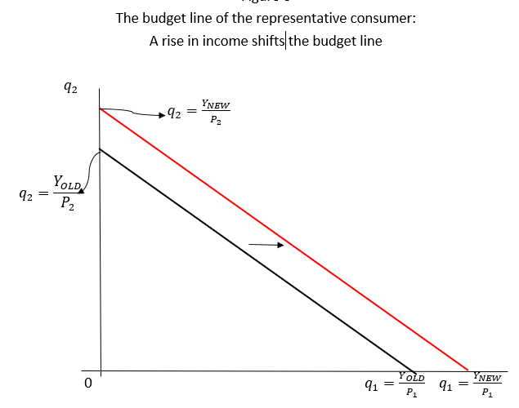
MOT1421 Economic Foundations The Neoclassical theory of demand
Suppose the income
of the consumer
increases. What
happens to the
budget constraint?

Slide 11
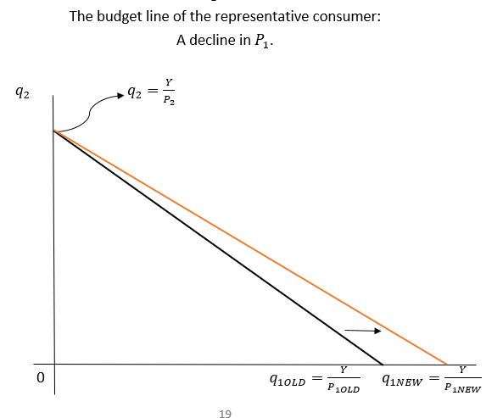
MOT1421 Economic Foundations The Neoclassical theory of demand
Suppose P₁
declines.
What
happens to the
budget constraint?

Slide 12
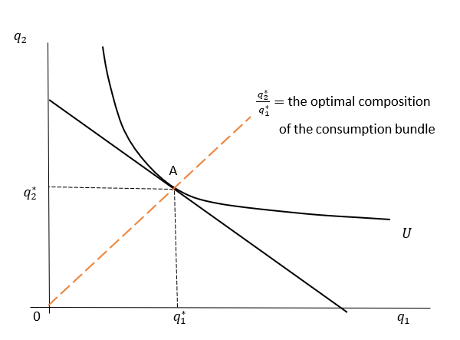

MOT1421 Economic Foundations The Neoclassical theory of demand
Utility maximisation
by the consumer:
combining the budget
constraint and
the indifference curves.

Slide 13
MOT1421 Economic Foundations The Neoclassical theory of demand
To derive the demand function (of the representative consumer), we will perform two (thought) experiments:
Experiment 1: suppose the income of the consumer increases.
Experiment 2: suppose the price of good 1 declines.
What is the utility-maximising response of the representative consumer?

Slide 14
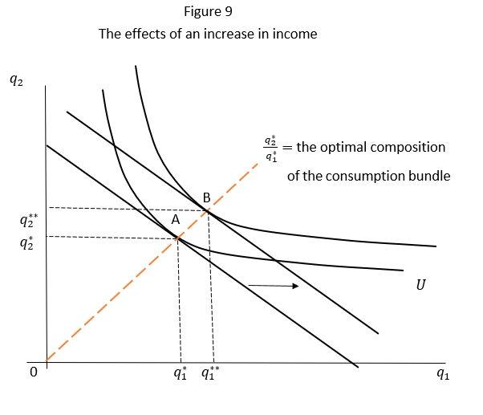
MOT1421 Economic Foundations The Neoclassical theory of demand
Experiment 1:
an increase in
consumer income

Slide 15
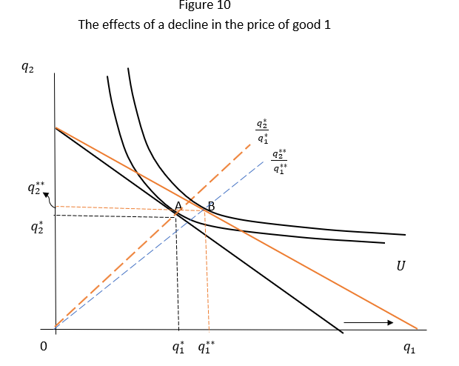
MOT1421 Economic Foundations The Neoclassical theory of demand
Experiment 2:
a decline in the
price of good 1

Slide 16
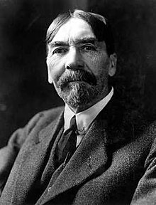
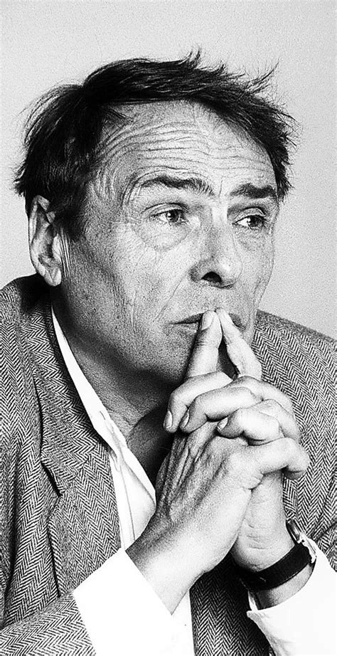
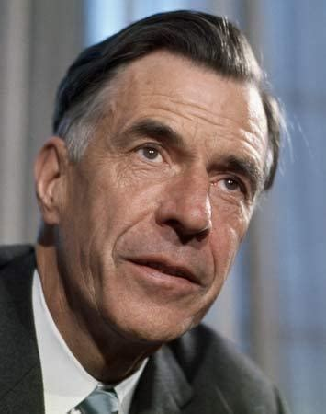
MOT1421 Economic Foundations The Neoclassical theory of demand
Next time:
Substitution effect; income effect; total effect of a price change
Price and income elasticities of demand
Giffen good
Alternative theories of consumer demand:
Thorstein Veblen (left)
Pierre Bourdieu (centre)
John Kenneth Galbraith (right)

